Slide 1
Hotel Bookings Data Analysis Pfizer Assessment
JAIGANESAN N
04-06-2023

Slide 2
Project Recap
Our project aimed to analyze the performance of the hotel using data collected from the online portal, stored in the 'hotel_bookings.xlsx' file.
The leadership team sought a summary of overall performance and booking details to identify areas for improvement. We conducted a thorough analysis and provided recommendations for potential wins.
The team was open to all types of analysis to enhance their business. Our project encompassed data exploration, trend identification, and actionable recommendations.
We presented the findings to the leadership team, emphasizing key metrics, customer preferences, revenue drivers, and opportunities for improvement. Overall, our project aimed to drive data-driven decisions and foster positive changes in the hotel's business operations.

Slide 3
Dataset Constraints :
In Customer Type, 95 % of the data is Transient and transient party data.
There is two kind hotel type in data set which has Resort Hotel and City Hotel. But Data Related to City Hotel in Dataset is 0.1 % .So we can’t made conclusion for city hotel with these amount of data. So We identified that this dataset is biased.
But Considering All this, we did analysis, made conclusion and have some suggestion to improve the business.

Slide 4
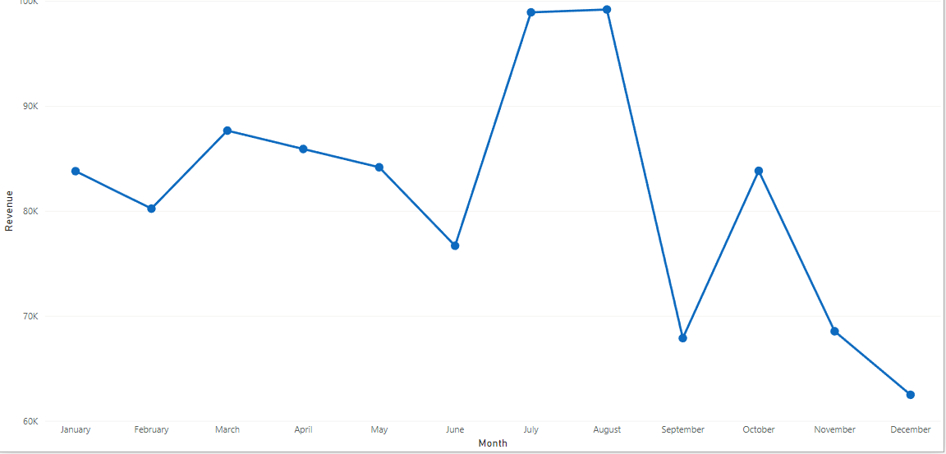
Revenue Based on Month
July and September months are highly performed and highly Revenue Generated months.
In 2016 and 2017 , January to April months are generates high revenue.
So Late Winter, spring, Summer season Performs well. So Marketing team need to focus more on this season.

Slide 5
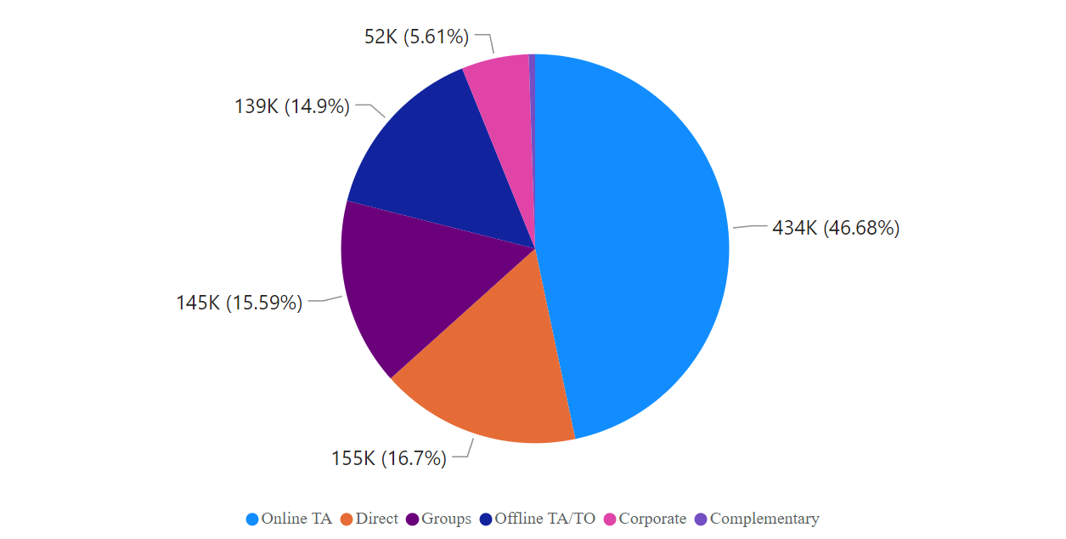
Revenue Based on Marketing Segment : Customer Type : Transient & Transient-Party
Transient and Transient-Party customers prefers online TA more.
Direct and Groupings segment also have some potentials.

Slide 6
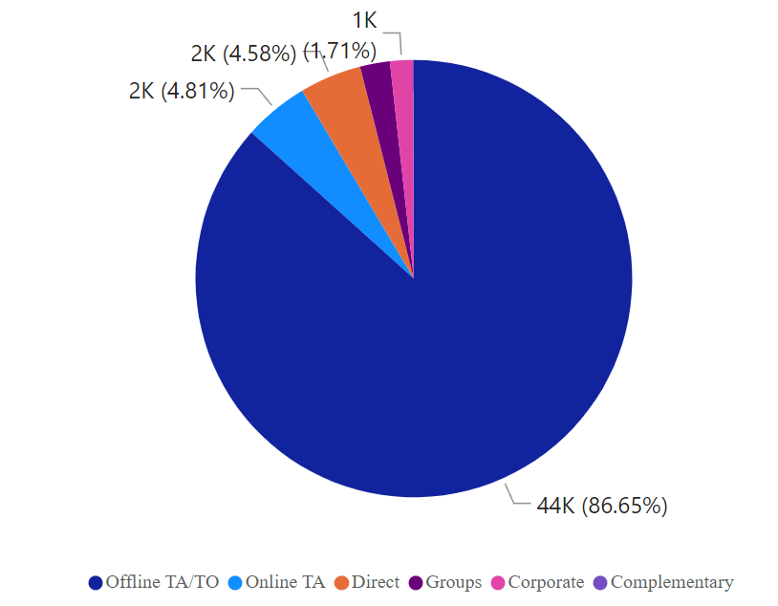
Revenue Based on Marketing Segment : Customer Type : Group & Contract
Group and Contract type customers prefers Offline TA/TO more.
Market segment offline TA/TO should focus more on Group and Contract type of customers.

Slide 7
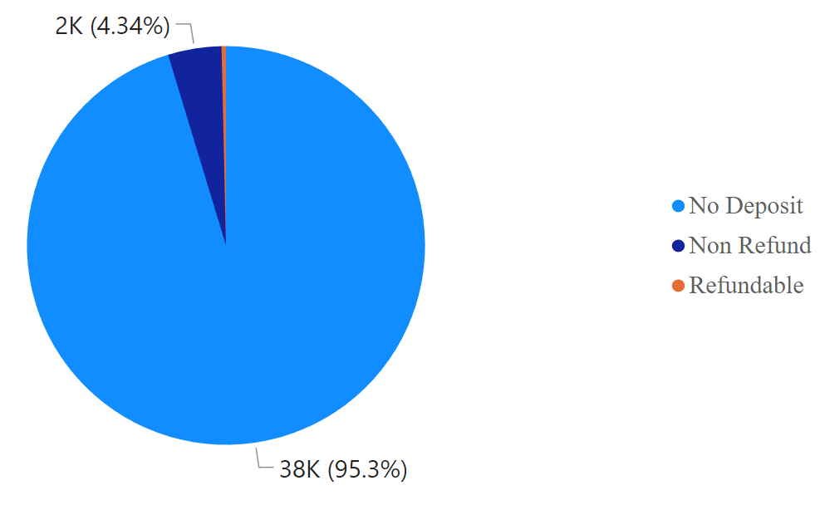
Bookings Based on Deposit type :
Customers Prefers more on No deposits for bookings rooms.
Weird Findings :
1.Non-Refund Deposit type has cancelation 94.9 %.
2.Refund Deposit type has cancelation 14.8 %

Slide 8
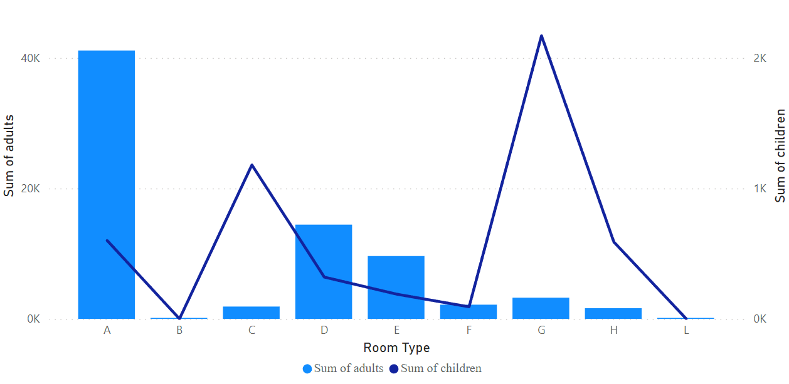
Adult’s and Children’s Room Preference
Adults Prefers A,D,E Room Type.
Children Prefers G,C Room Type.

Slide 9
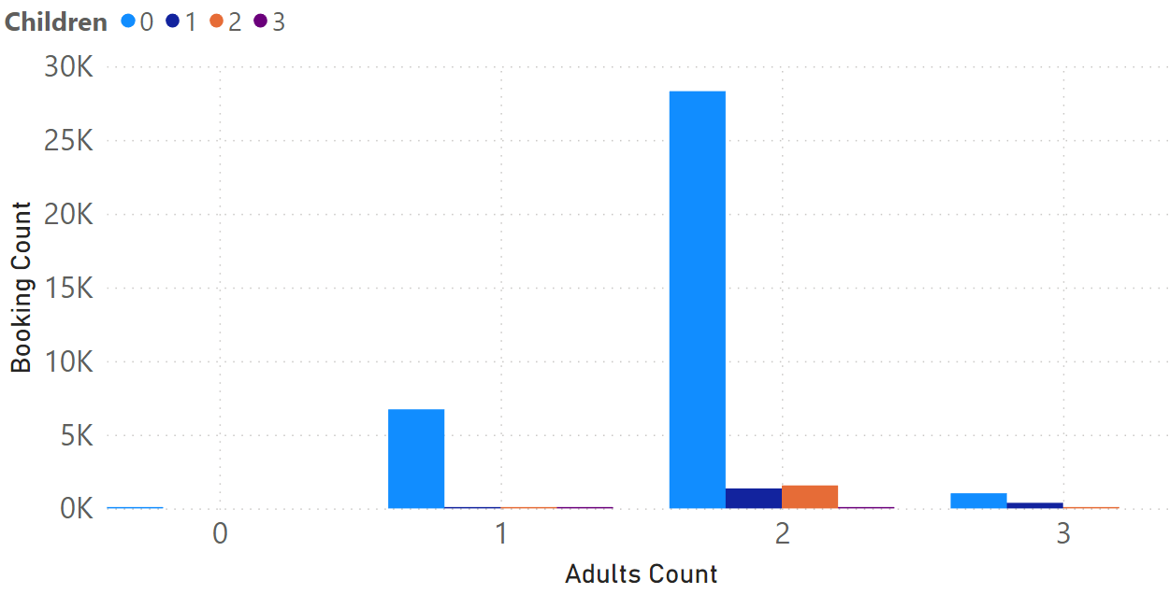
Bookings based on Adults with Children :
Adults Count with 2 and 3 Book hotel with Children Count 1,2,3 so It’s kind of family.
So Marketing team should focus more on Family .

Slide 10
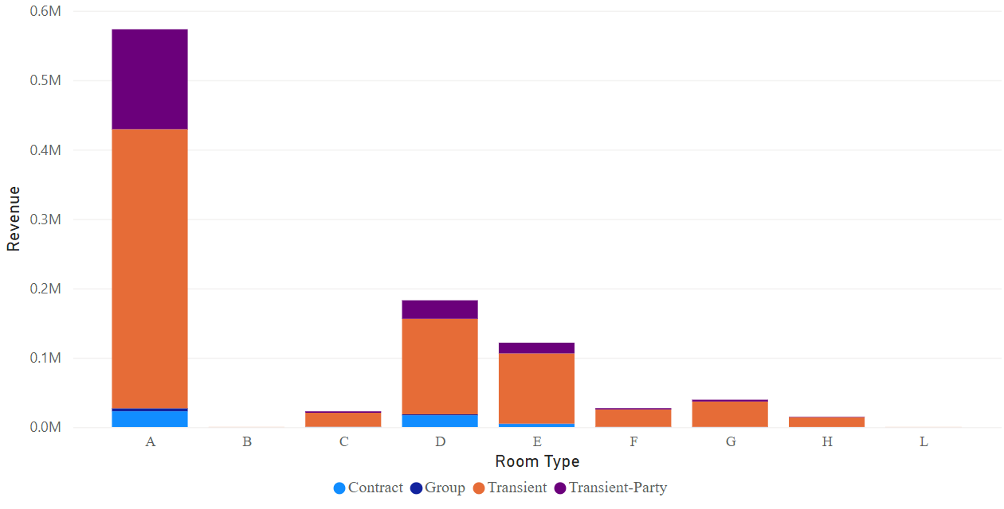
Revenue Based on Room Type with Customer Type
A kind of Room Preferred by most of the customers.
Hospitality Team need to focus on D,E kind of room and improve quality.
Contract Type Customer Prefers A and D kind of Rooms.
Transient-Party Customers Prefers A,D,E kind of Rooms.

Slide 11
Other Findings :
Percentage of Transient Customers cancelling their booking is 30.7 % which is considerable high compares to others .
Revenue from Bookings Cancelled and Non Refund Amount is 41 K USD(4 %) which is considerable. It also affect the customers Retention and Repeated Guests.

Slide 12
Conclusion :
Our analysis of the hotel's performance based on the dataset has provided valuable insights for the leadership team.
We have identified key metrics, trends, and areas of improvement that have the potential to enhance the hotel's business. By leveraging these findings, the leadership team can make informed decisions to optimize revenue generation, improve customer satisfaction, and streamline operations.
The project's comprehensive report and presentation have equipped the team with actionable recommendations to implement targeted strategies and drive positive changes.
With a commitment to data-driven decision-making, the hotel management is well-positioned to capitalize on the suggested potential wins and elevate their business to new heights of success.

Slide 13
Thank you

